Slide 1

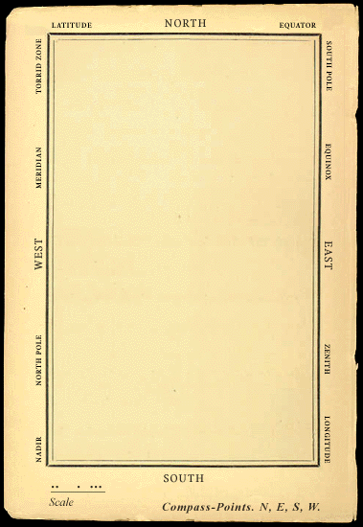
Common sense web ‘a map they could all understand’
He had bought a large map representing the sea, Without the least vestige of land: And the crew were much pleased when they found it to be A map they could all understand. ‘What’s the good of Mercator’s North Poles and Equators, Tropics, Zones, and Meridian Lines?’ So the Bellman would cry: and the crew would reply, ‘They are merely conventional signs!’ ‘Other maps are such shapes, with their islands and capes! But we’ve got our brave Captain to thank’ (So the crew would protest) ‘that he’s bought us the best— A perfect and absolute blank!’ [Lewis Carroll, ‘The hunting of the Snark’]

Slide 2
agenda
9:30 – 10:00 Welcome & Goal
10:00 – 10:30 Common Sense Overview
10:30 – 11:15 Projects & Layers
11:15 – 12:00 Getting Started
13:00 - 14:00 Diving Deeper
14:00 – Hands on, Community, etc.

Slide 3
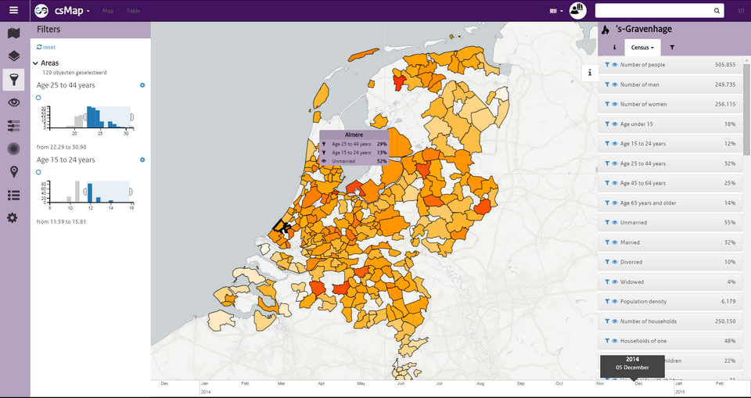
introduction
Common Sense Web is a user friendly web-based GIS application, with a focus on collaboration and coupling to simulations.
It arose out of the need to offer TNO models and visualisations to users in many projects
Technically, it is split between common libraries and frontend GUI, so its easy to roll your own
Is open source. MIT license, so open for commercial use as well. You can fork us on GitHub. Live demo of standalone functionality.
Users: eScienceCentre, NLR, Fraunhofer IAIS. Evaluation: Deltares

Slide 4
started in September 2014, already used IN
Healthcare
Zorg|op|de|kaart
AHTI Amsterdam
Defence, Safety and Security
Military Space (+NLR)
TO2 Crisis Mgmt (+NLR, Deltares, RIKILT)
TO2 Critical Infrastructure Protection
Real-time Intelligence centre
Brandweer Nederland
EU
ECODISTR-ICT
CIPRNet (Fraunhofer)
Dashboards
UrbanStrategy
CityDashboard Rotterdam
CityDashboard Eindhoven
Verkeerdemo
Afval Almere
Buiksloterham
Cycle Dashboard
Fit2Perform
Connekt Mobiliteit
Archeology
POVtree (eScienceCentre)

Slide 5
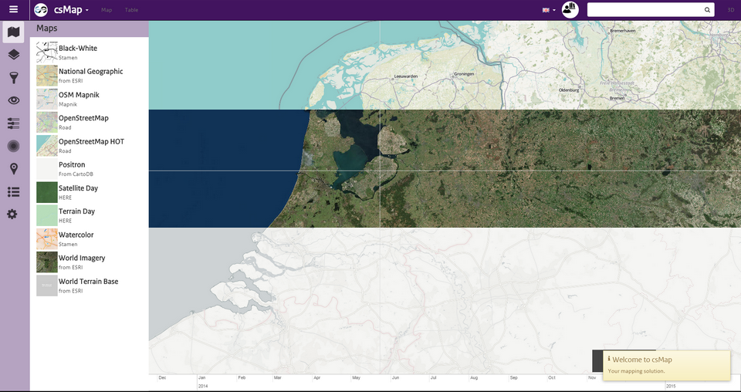
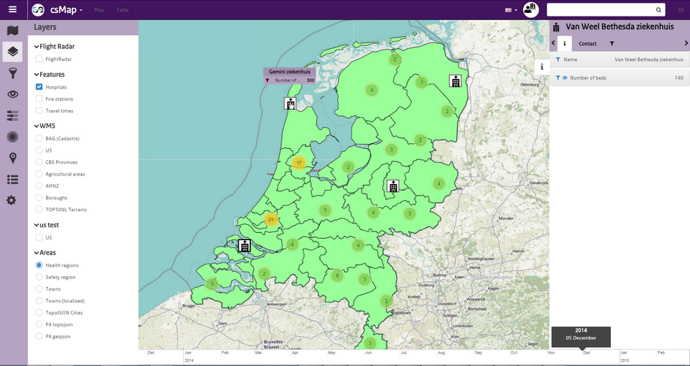
COMMON SENSE OVERVIEW
Base Layers
Select different base layers
You can add your own (e.g. mbtiles)
E.g. OpenStreetMap HOT, Satellite, or Positron
Map Layers
E.g. geojson, topojson, grid raster files
Also WMS, hierarchical, heatmap or MCA
Icons are based on feature or property

Slide 6
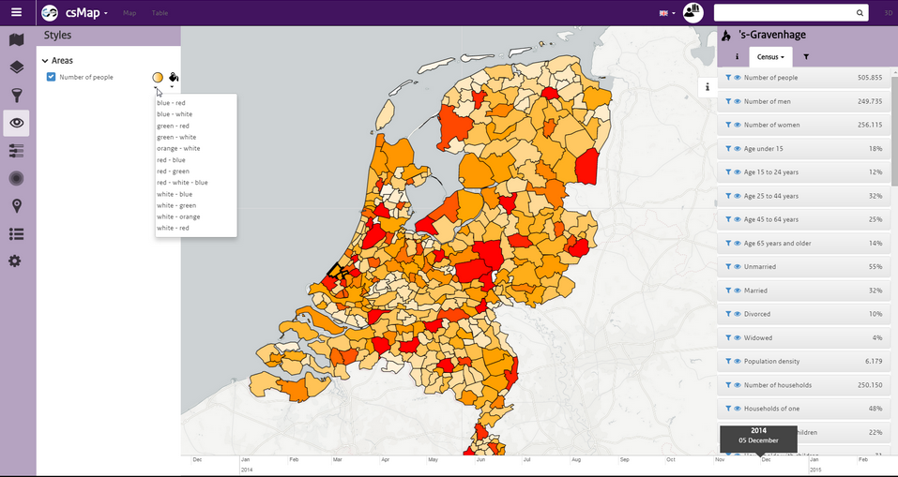
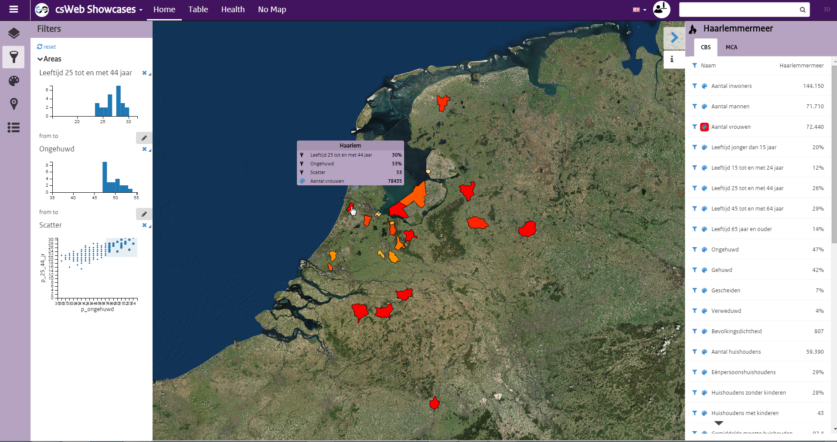
COMMON SENSE OVERVIEW
Styles
Highlight an area or feature using a predefined color scheme
E.g. the number of people in Dutch towns
Filters
Specify which features are shown
E.g. a high % of unmarried people in the age category 25-44y, styled by the % of women

Slide 7
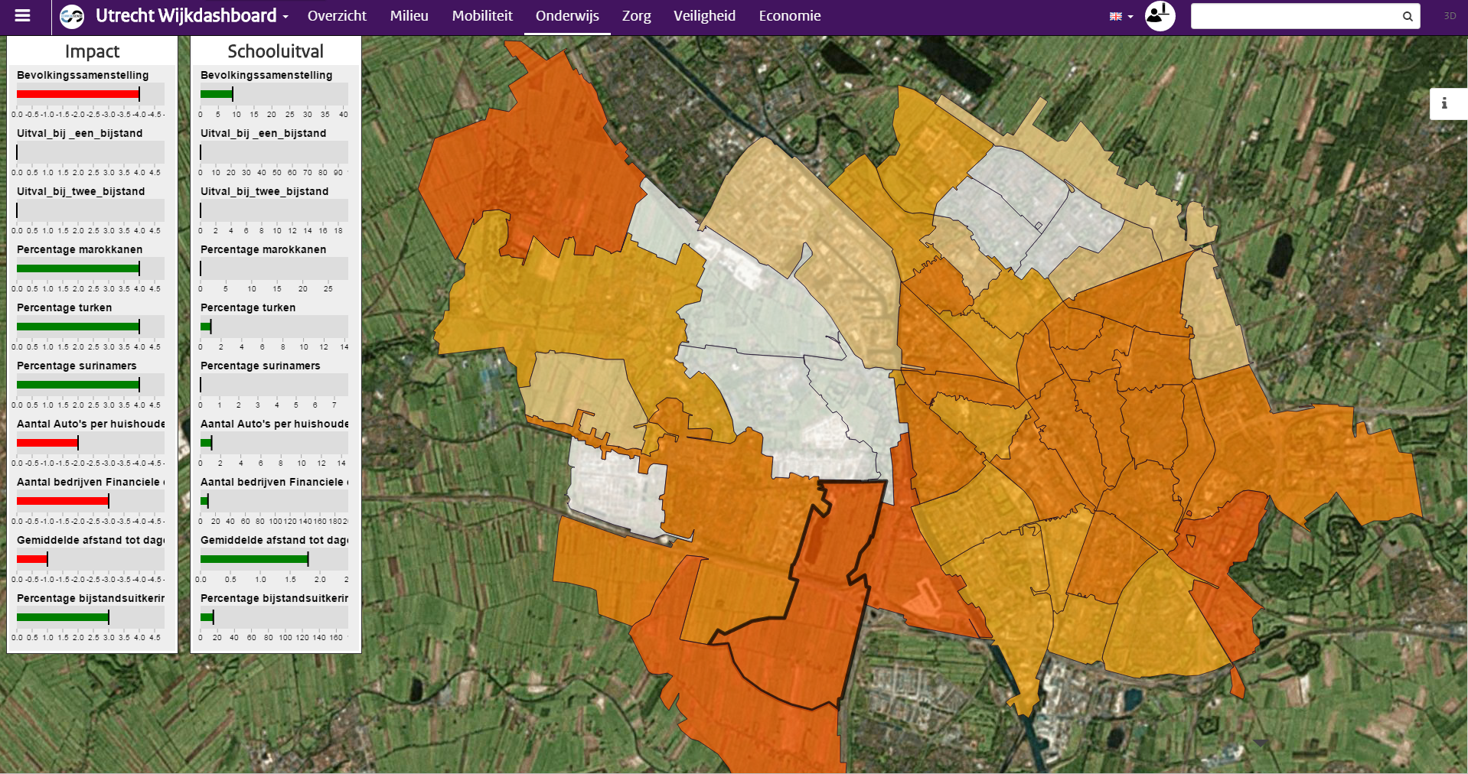
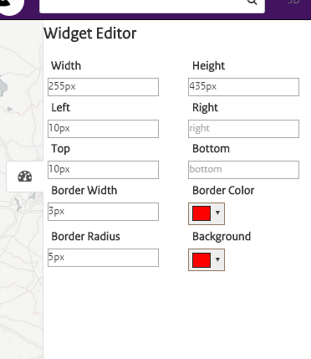
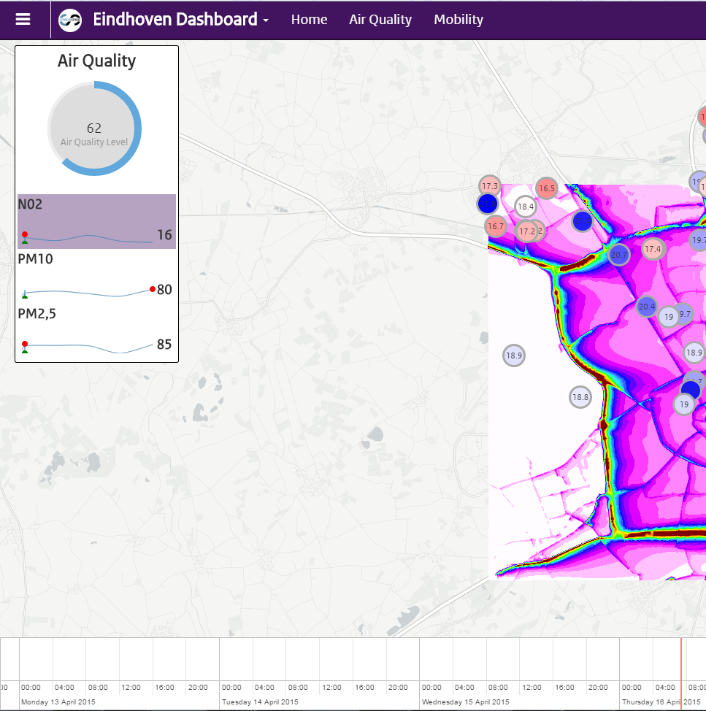
COMMON SENSE OVERVIEW
Dashboards (tabs)
Theme/Role specific dashboards/portals
Customizable widgets
Configure viewbound, layers, timeline, etc.
Widgets
Reusable components
E.g. for HTML, Markdown, charts, gauges

Slide 8
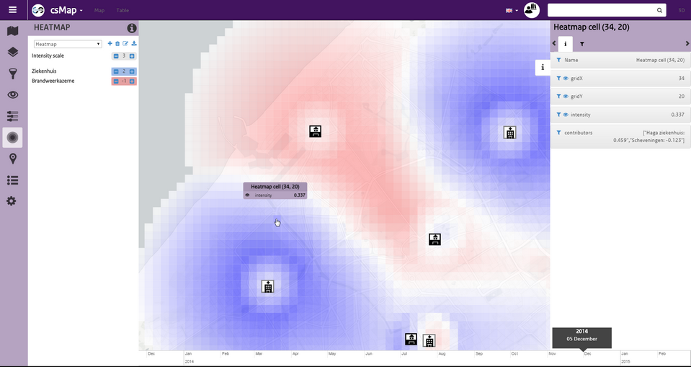
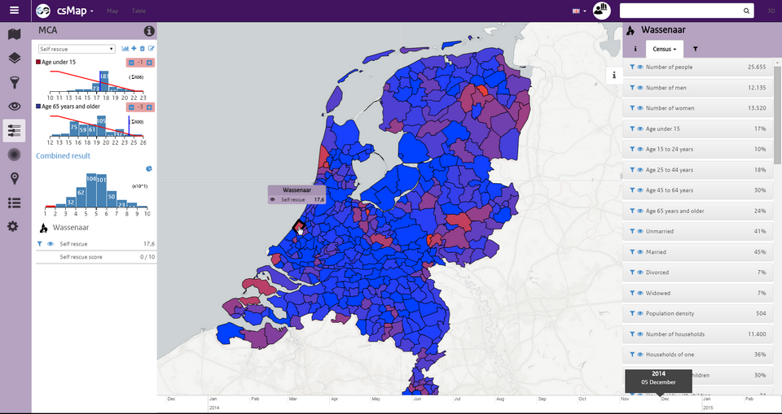
COMMON SENSE OVERVIEW
Heatmaps
Select features (properties) of interest
Set ideality parameters
Weight features
MCA (Multi-Criteria Analysis)
Select properties of interest
Weight them
Score and rank them

Slide 9
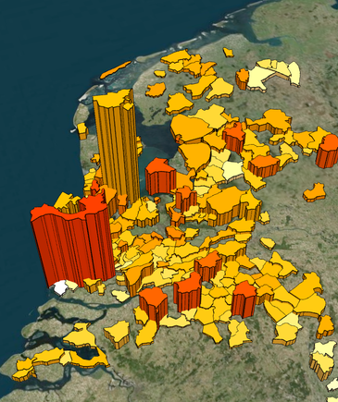
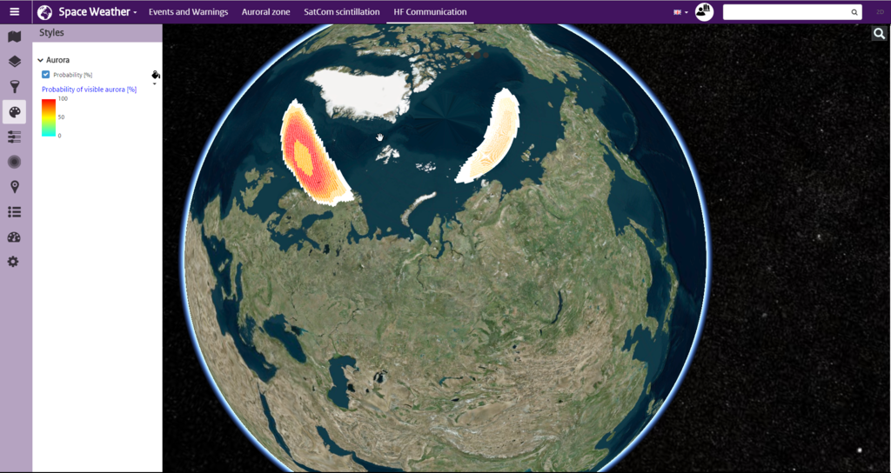
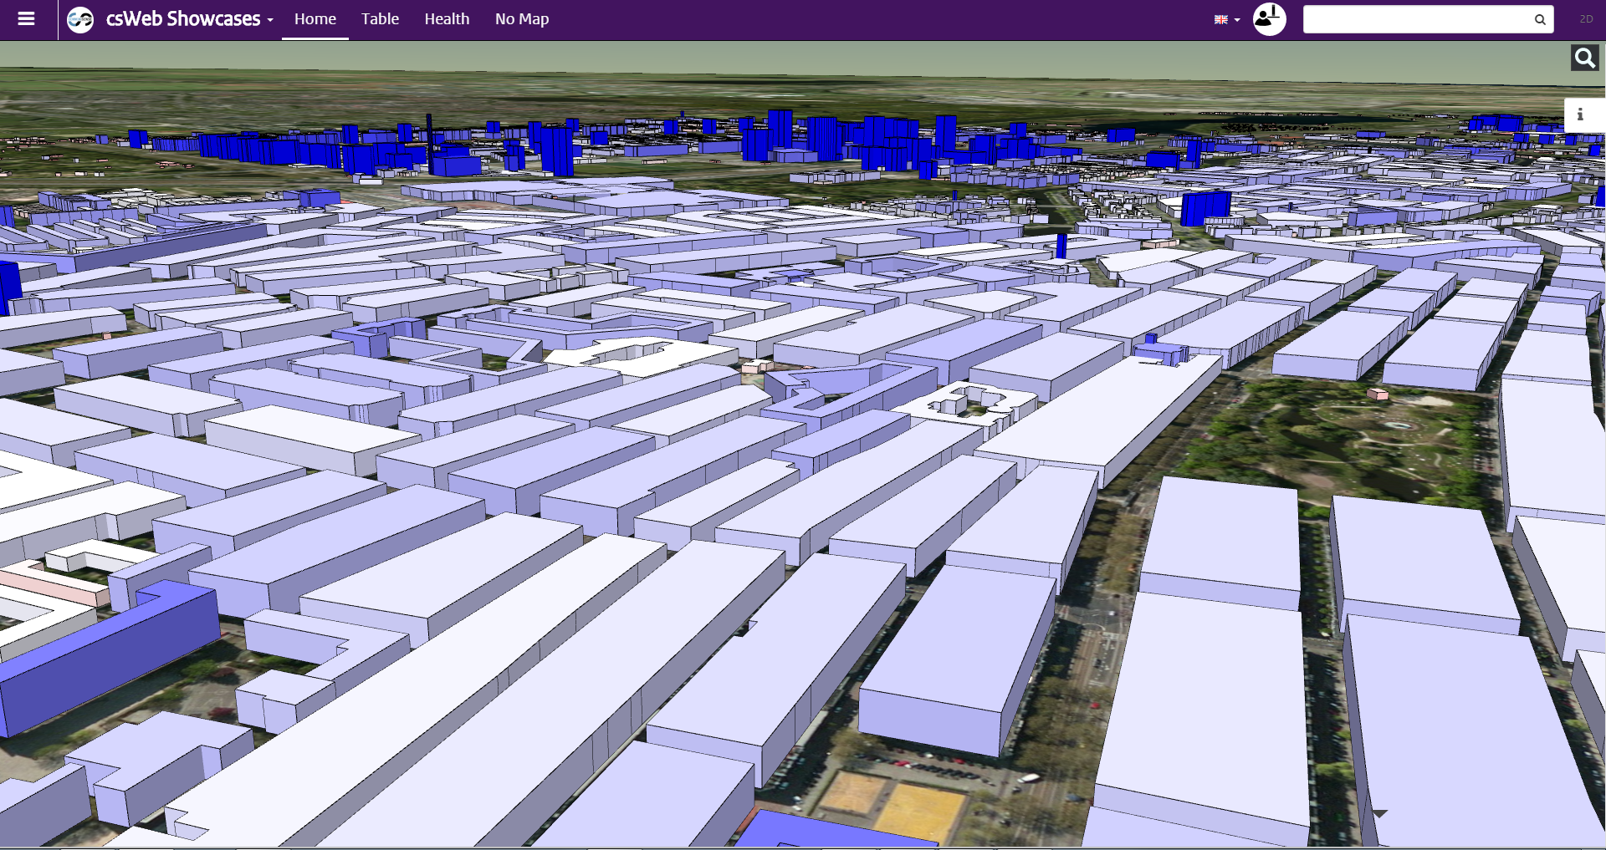
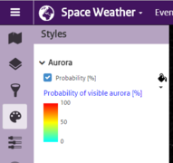
Common Sense overview
Legends
Describe colour range and property
Select by default
3D Rendering
Extends 2d view with 3d models
New styling options

Slide 10
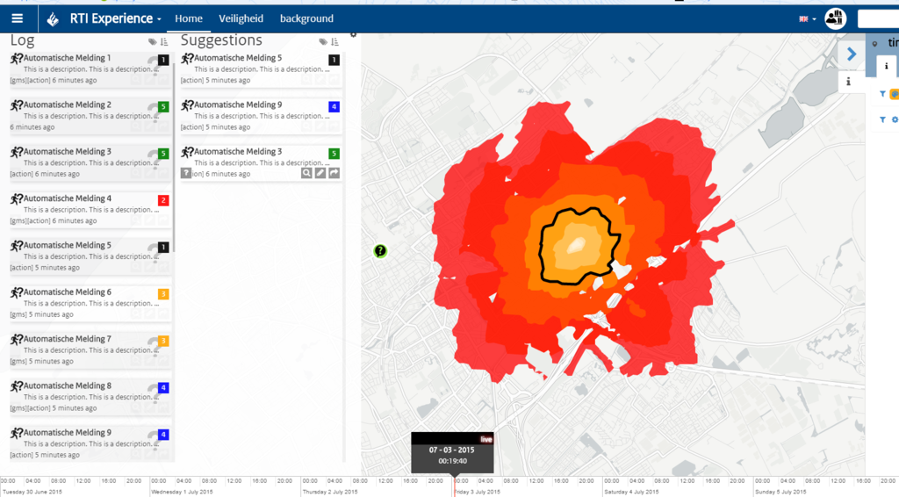
Common Sense overview
Kanban boards
Show news feeds/tweets/messages in a log
Answer questions
Allocate tasks
ActionService models
Add specific functionality to certain features
E.g. Compute accessible area that you can reach walking|driving|etc. after a certain time.

Slide 11
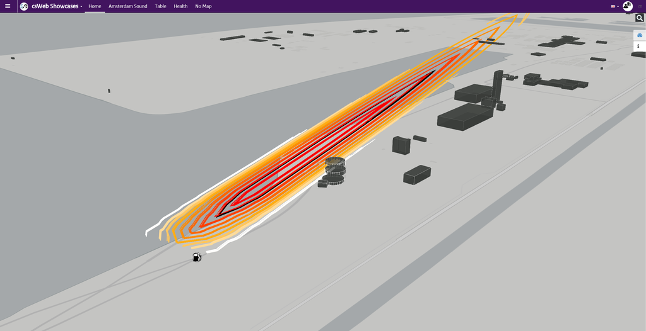
COMMON SENSE OVERVIEW
Example ActionService
Gas explosion dispersion in 3D
Excel2Map
Select your data (properties)
Describe your layer (title, group)
Push to csWeb: use existing geometry or look up address

Slide 12
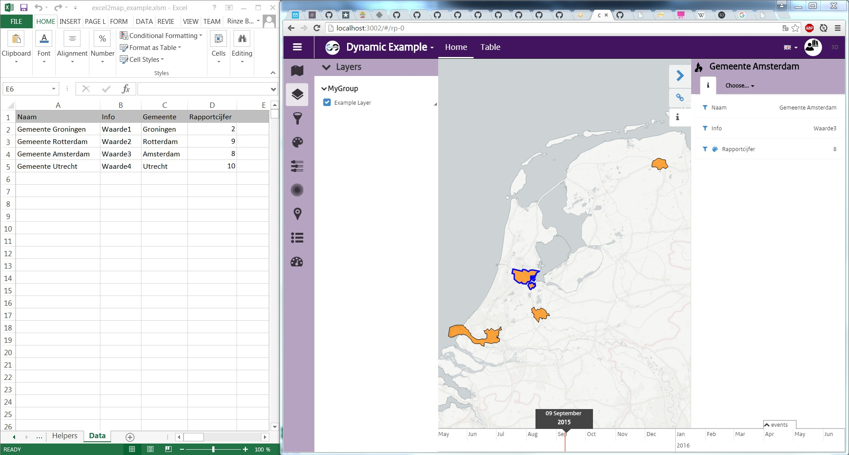
Notes:
Excel2Map

Slide 13
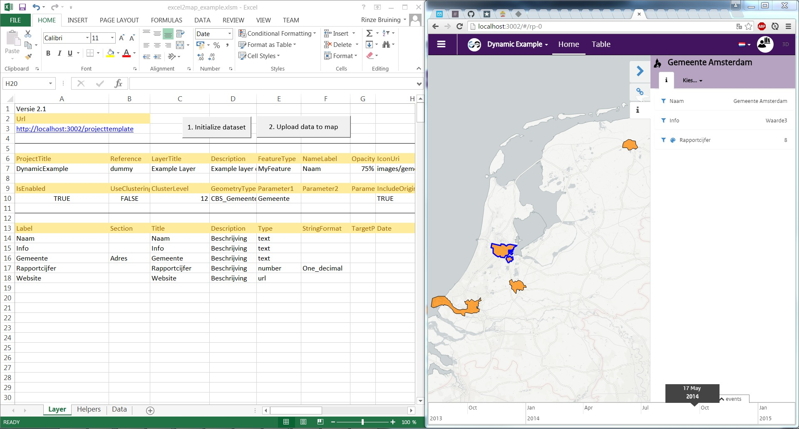
Notes:
Excel2Map

Slide 14
COMMON SENSE OVERVIEW
Other functionality
Localization support (GUI and data)
Time aware
Switching between projects
Expert levels

Slide 15
Collaboration and SIMULATION
Share layers dynamically between clients
REST
MQTT, an Active-MQ based PubSub message bus
WebSockets e.g. Common sense desktop
IMB (TNO PubSub message bus)
Calculation models for features on the map e.g.
Accessibility service
What-if service
Allocating tasks
In progress
Edit layers: add new features, store them
Sharing of layers and GIS services
Sharing of location
Authentication
Chat
Better support for tablets and smartphones
SimulationService
Data warehouse: store, publish and transform your data

Slide 16
Modelling & Simulation architecture (in progress)
SimMgmt
ApiMngr
csWeb
Browser
Time mgmt
Sim. configuration
Flooding sim
Road accessibility sim
Train accessibility sim
Electricity availability sim
Critical infrastructure status sim
Communication availability sim
SimSvc
ApiMngr
ApiMngr
Node.js
HlaSvc
Java svc
C2 clients
C#
Convert HLA objects to REST
Current interfaces: WebSockets, REST, MQTT
Most modules will run in Docker containers

Slide 17
Technology

Slide 18
Technology stack
Server
Node.js + Express
Client
Angularjs (framework)
Leaflet (map)
Bootstrap (responsive web style)
Programming language
TypeScript (compiles to JavaScript)

Slide 19
Solution, Project & layers
Solution (projects.json)
Is mainly used for managing multiple themes, i.e. each main theme in the application can have its own set of maps and layers, so you can easily switch between them
Properties
title (deprecated)
maxBounds (map pan limit) and viewBounds (initial view)
southWest, northEast
baselayers:
title, (subtitle)
url
isDefault
minZoom and maxZoom level
subdomains
attribution
preview (image url)
Projects (1+)
title
url: links to project.json file

Slide 20
Solution, Project & layers
Project (projects.json)
Groups strongly related basemaps, group layers, and layers, as well as feature and property types. Is also used for specifying configuration and user privileges.
Properties
title, description, url and logo (img)
maxBounds and viewBounds
baselayers
connected (bool)
expertMode (1, 2, 3 = beginner… expert)
featureTypes, propertyTypeData (next)
userPrivileges (mca|heatmap expertMode)
timeline
Start, end (±msec since 1/1/1970)
range, zoomLevelName, isLive)
groups (of map layers)
title, description
clustering (bool), clusterLevel
layers
id (title), reference (key)
type (geojson, topojson, wms, dynamicgeojson)
url: links to data source
enabled (bool), opacity (0…100)

Slide 21
Feature Types
Describe the visual representation of a (point or area) feature on the map.
Specified in project.json (so a feature type can be reused across map layers) or geo|topo-json
Can contain propertyTypeData [array] or propertyTypeKeys (references project propertyTypeData)
Is a dictionary [FeatureTypeName]: FeatureType
name
style
fillColor, strokeColor (e.g. #ffffff00 or name)
strokeWidth
innerTextProperty, innerTextSize
drawingMode (point)
rotate, rotateProperty
iconWidth, iconHeight
iconUri
Plain vanilla image url
Or with property reference, e.g. img/EnergyLevel_{energyLevel}.png
sensors & timestamps

Slide 22
Property Types
PropertyTypes describe how a geojson property should be displayed to the user.
label
title, description
type
section
stringFormat
visibleInCallout
isSearchable
minValue, maxValue
defaultValue
options, languages, legend

Slide 23
Localisation
Support for multiple languages is built in:
GUI key-based translation files (English and Dutch)
Data key-based languages (dictionary) objects for (group) layers and property types.
languages
key: language (e.g. ‘en’ or ‘nl’)
title (e.g. of layer), name (e.g. of feature), description, section,
…
"languages": {
"nl": {
"title": "Ziekenhuizen",
"description": "De locaties van de Nederlandse ziekenhuizen."
},
"en": {
"title": "Hospitals",
"description": "These are the locations of the Dutch hospitals."
}
}
…

Slide 24
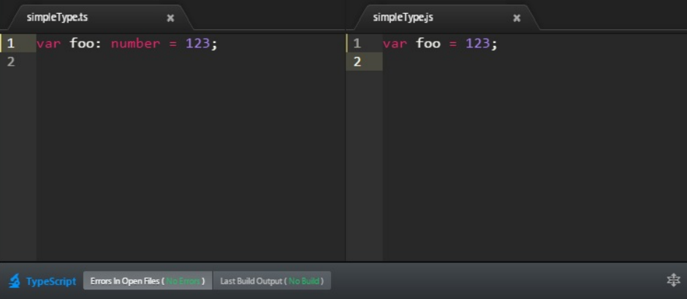
GETTING STARTED
Read the manual
Node.js, a lightweight server
TypeScript (free ebooks [1], [2]), compiles to js
csWEB
NPM & BOWER for managing external dependencies
GULP build tool
Open source IDE: Atom+atom-typescript plugin

Slide 25
DIVING DEEPER
Angular
Modules / Directives
Services
MessageBus
LayerService
LayerSources
Renderers
LayerService
Open solution
Open project
Open Layer
MCA
Filtering
Styling
Layer Sources
GeoJson
TileLayer
Wms
Heatmap
Dynamic Geojson
Map Renderer
Leaflet
Cesium

Slide 26
csWeb
csComp
example
classes
public: Angular + Bootstrap + Leaflet, etc.
projectGroup
layer
solution
project
typeResource
feature
main files
index.html
app\app.ts
css\style.css
images\
data
projects
resourceTypes
templates
cs
dependencies
directives
BaseMapList
FilterList
StyleList
services
MapService
LayerService
MessageBus
DashboardService
csServerComp
api + creator
server: Node + Express + Socket.io, etc.
ApiServiceMgr
RssService
csServerComp (copy)
ProxyService
MapLayerFactry
bus + dynamic
MessageBus
DynamicProject
ClientConnection
DynamicLayer

Slide 27
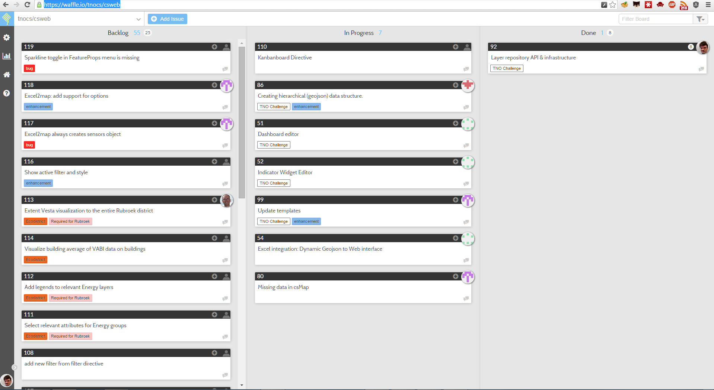
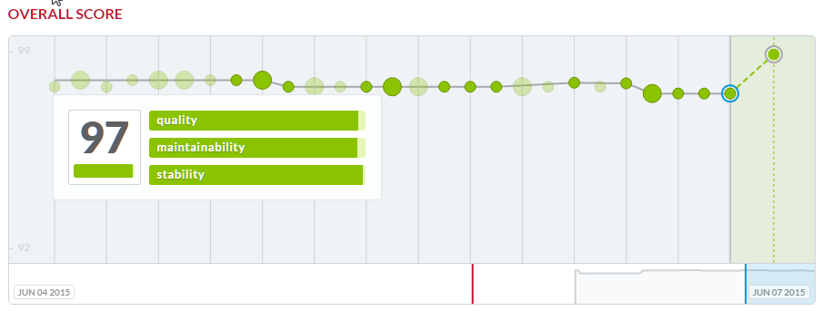
What’s next?
Community
Waffle, our Kanban board
Wiki on Github
Slack for supporting collaboration
TravisCI for Continuous Integration
Karma & Jasmine for Unit testing
Bithound, for code quality review

